Slide 1
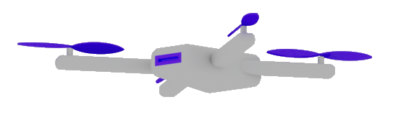

Advanced AI Development
MASTER CLASS
Dr. Damir Dobric
Lead Software Architect daenet GmbH / ACP Digital
Microsoft Regional Director,
Most Valuable Professional: AI

Slide 2

Architecting and Developing Custom Copilots and AI Agents
Dr. Damir Dobric
Lead Software Architect daenet GmbH / ACP Digital
Microsoft Regional Director,
Most Valuable Professional: AI

Slide 3

ML vs. GenAI What is different and why it is important?
Traditional ML
Lot of Data
Long Training
GenAI
Pretrained
GPT=General Pretrained Transformer

Slide 4
AI Services
Open AI
https://platform.openai.com/docs/models
Azure AI Foundry https://ai.azure.com/
Request Access to Azure OpenAI Service (microsoft.com)

Slide 5
TOKENS

Slide 6

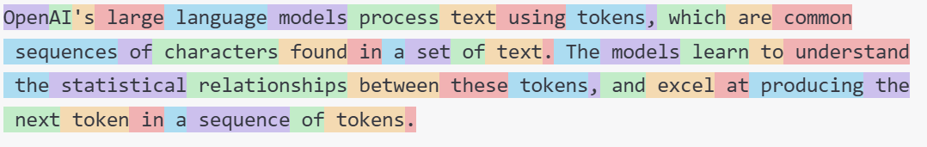
What are Tokens?
1 token ~= 4 chars in English
1 token ~= ¾ words
100 tokens ~= 75 words
Byte Pare Encoding (Gage,1994): Wikipedia
What are tokens and how to count them?
Token Pricing: Pricing (openai.com)

Slide 7
DEMO
Tokenizer
Creating tokens in C#

Slide 8
EMBEDDINGS

Slide 9
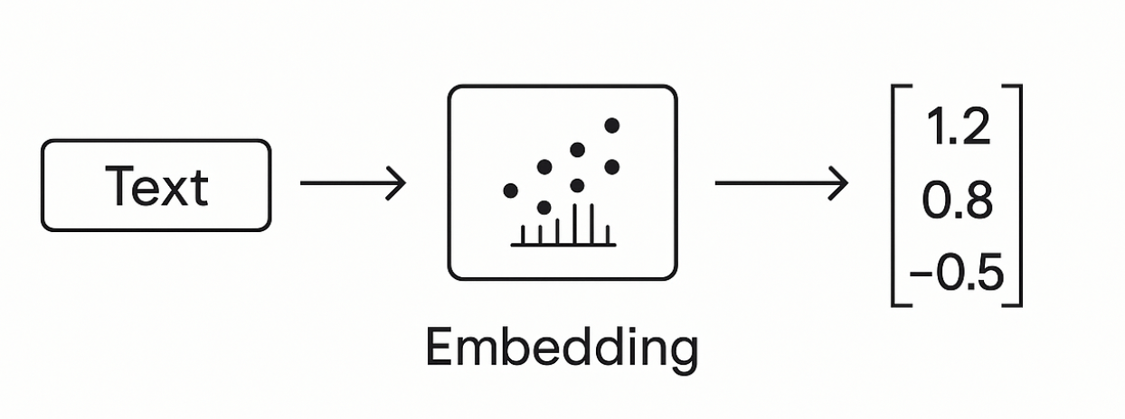
Embeddings
Making a vector from text

Slide 10
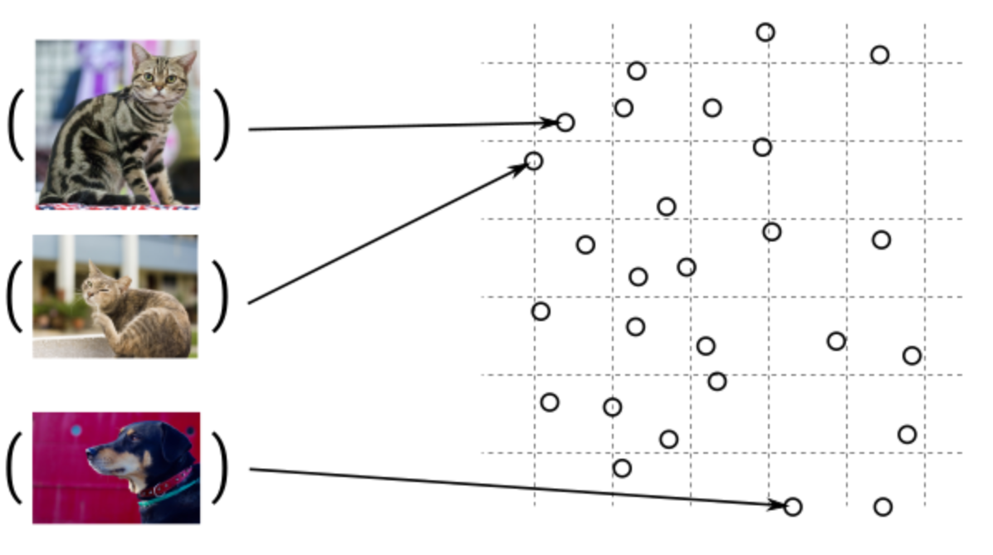
Guess, today is a nice day in Palma
Embedding Models
Today is a typical German rainy day
Two things are infinite: the universe and human stupidity; and I'm not sure about the universe.

Slide 11

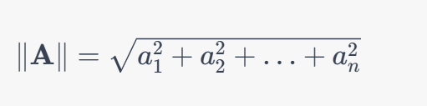
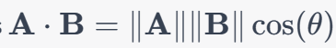
Similarity Between Multidimensional Vectors
Dot Product
The Norm
Cosine Similarity

Slide 12
When to use Embeddings?
Semantic Search
Classification
Clustering
Recommendations
. . .

Slide 13
DEMO
Consuming Embedding Model with HTTP/Post
Creating Embeddings in C#

Slide 14
VECTOR DATABASES

Slide 15
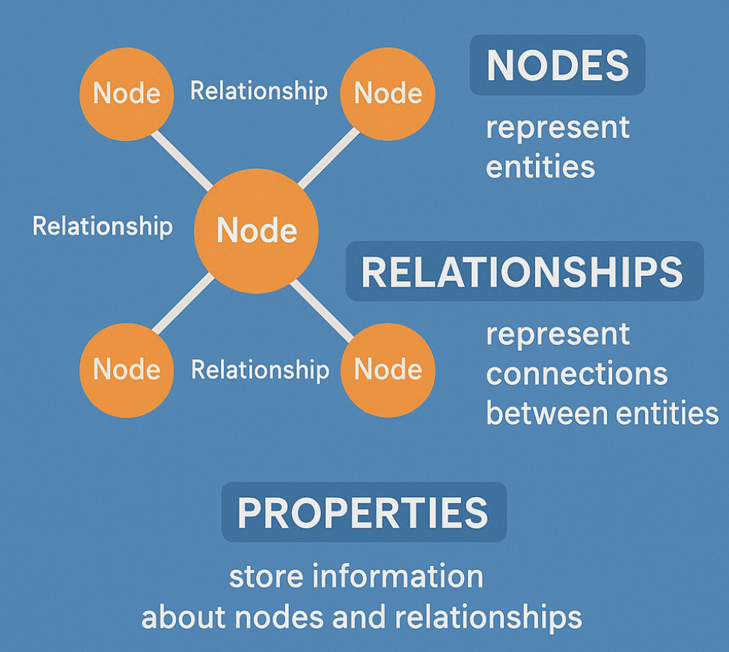
Graph Databases

Slide 16
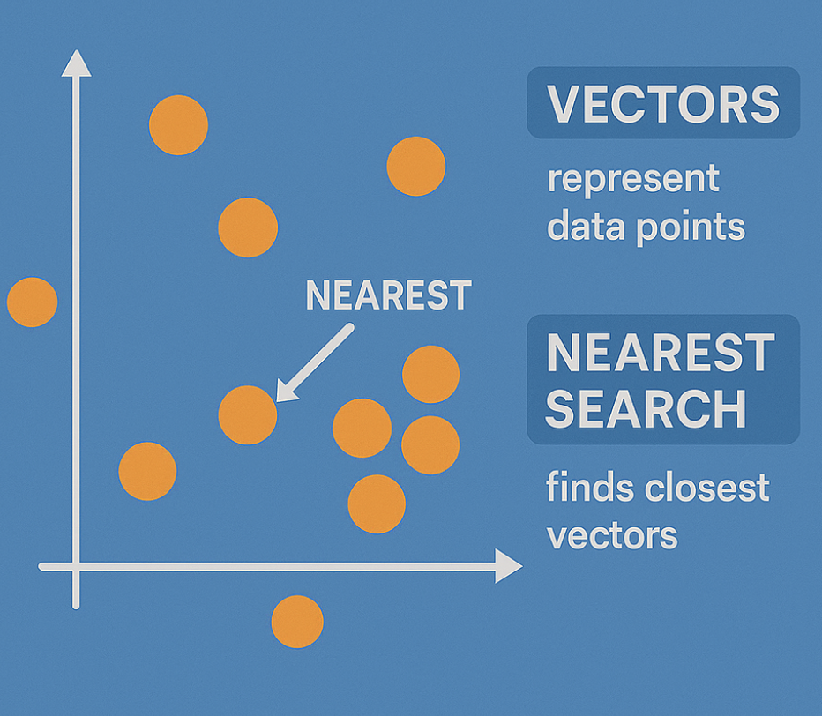
Embeddings in GraphDB

Slide 17
Vector DBs
SqlServer 2025 Native Vector Search
Quadrant
CosmosDB
…

Slide 18
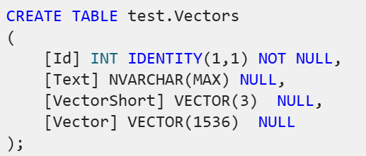
SqlServer 2025 Native Vector Search
SqlServer 2025 Native Vector Search
In Azure
On-Prem
SQL Server Native Vector Search for .NET Developers

Slide 19

The New Vector Type
sqlCmd.Parameters.AddWithValue("@Vector", JsonSerializer.Serialize(new float[] { 1.12f, 2.22f, 3.33f }));
sqlCmd.Parameters.AddWithValue("@Vector", ‘[1.12, 2.22, 3.33]’);

Slide 20
DEMO
SQL Server Native Vector Search
SQL Server Native Vector
DECLARE @v1 VECTOR(2) = '[1,1]';
DECLARE @v2 VECTOR(2) = '[-1,-1]';
SELECT
VECTOR_DISTANCE('euclidean', @v1, @v2) AS euclidean,
VECTOR_DISTANCE('cosine', @v1, @v2) AS cosine,
VECTOR_DISTANCE('dot', @v1, @v2) AS negative_dot_product;

Slide 21
COMPLETION MODELS
How does all this work?

Slide 22
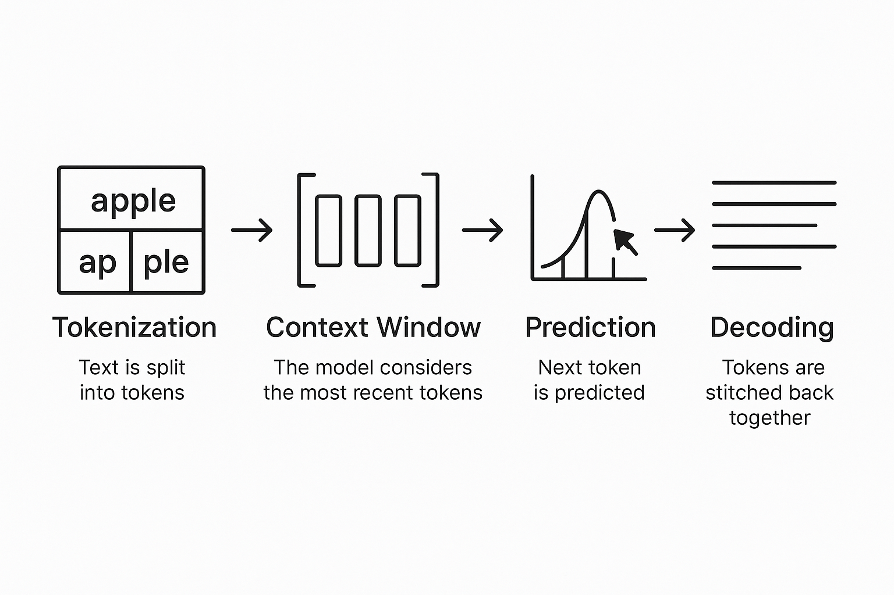
Completion Models
Text Completion Flow

Slide 23
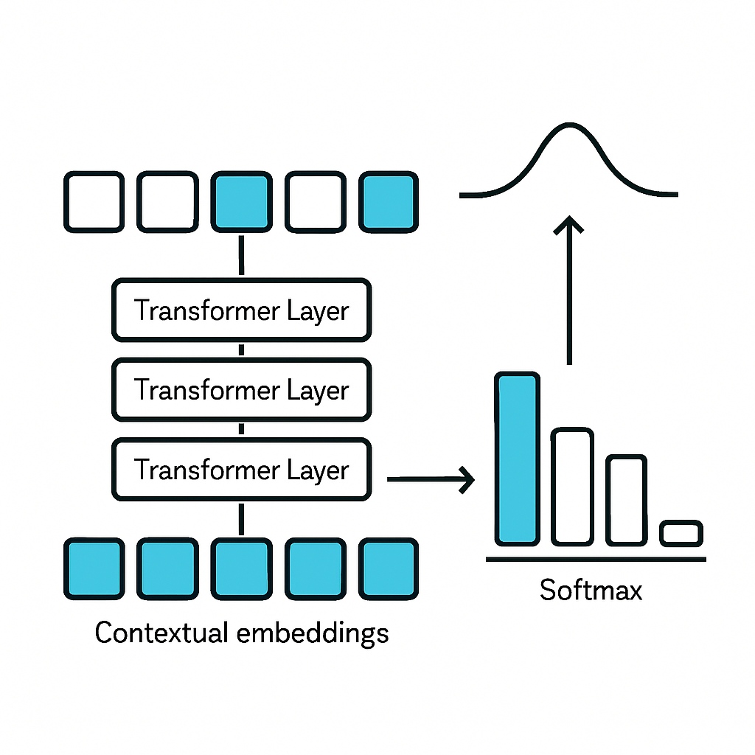
The algorithm
Transformers

Slide 24

DEMO
C# Application
Using OpenAI nuget package
Executing ChatCompletions
Presenting Probabilities

Slide 25
A Scientific look under the hub

Slide 26
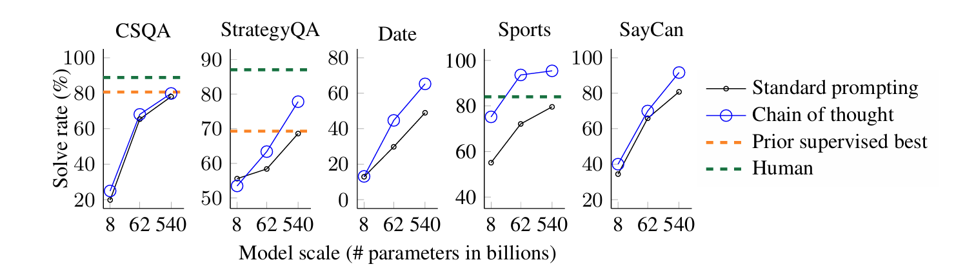
Chain of Tought
A prompting technique used to improve reasoning
Models think step by step before giving an answer.
Google Research, Brain Team
https://arxiv.org/abs/2201.11903

Slide 27
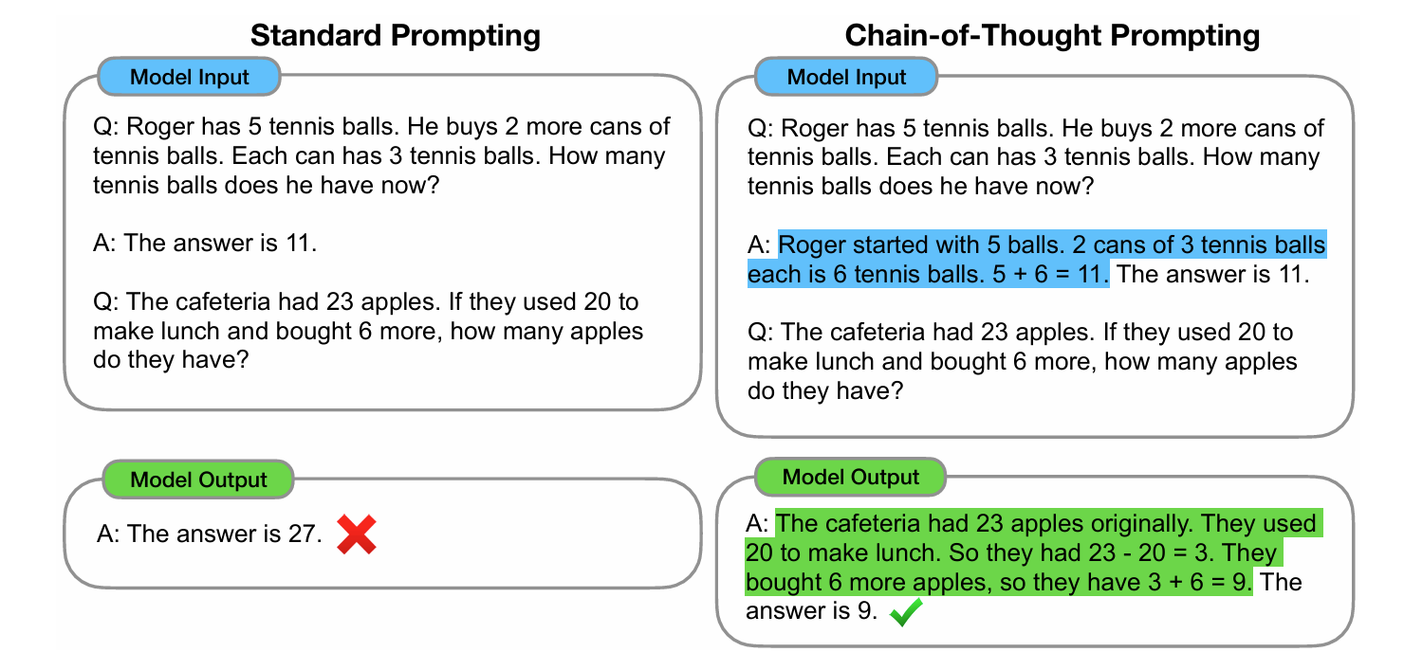
The Chain of Tought (CoT)

Slide 28
Reasoning
Common Models are
Outcome-Supervised Reward Models (ORM).
They use final answers
Reasoning Models
Receive Feedback on Each Step in Chain-of-Tought process
Process Reasoning Models (PRM)
https://cdn.openai.com/improving-mathematical-reasoning-with-process-supervision/Lets_Verify_Step_by_Step.pdf

Slide 29
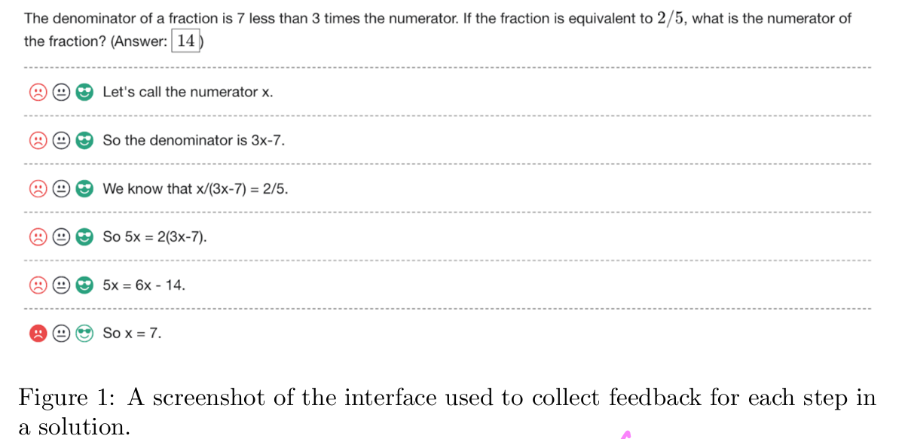
Human Supervised Learning

Slide 30
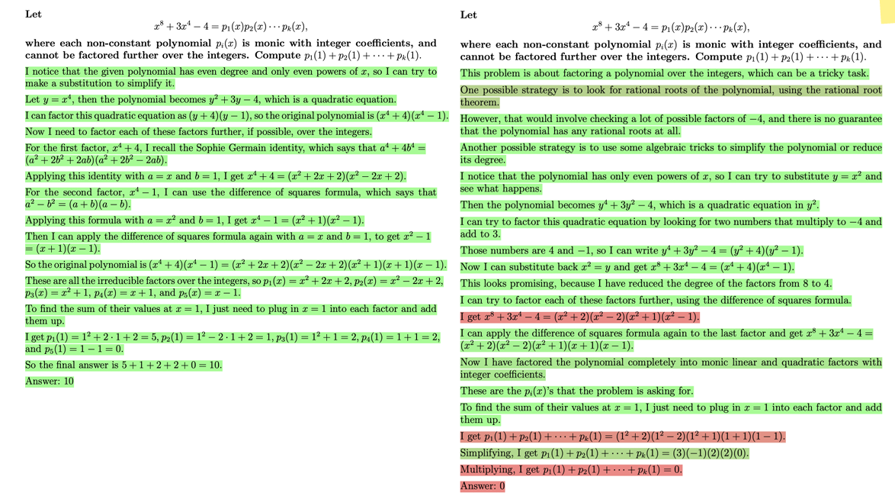

Slide 31
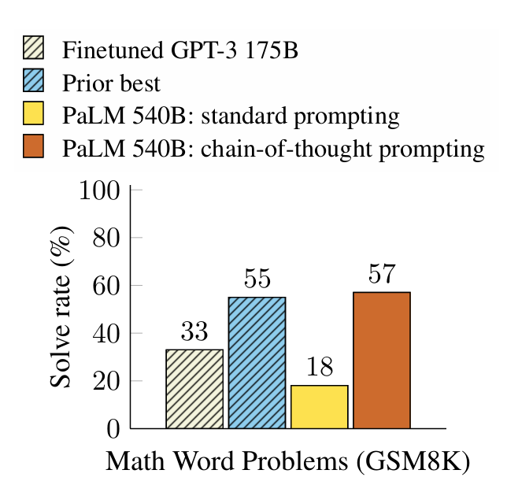
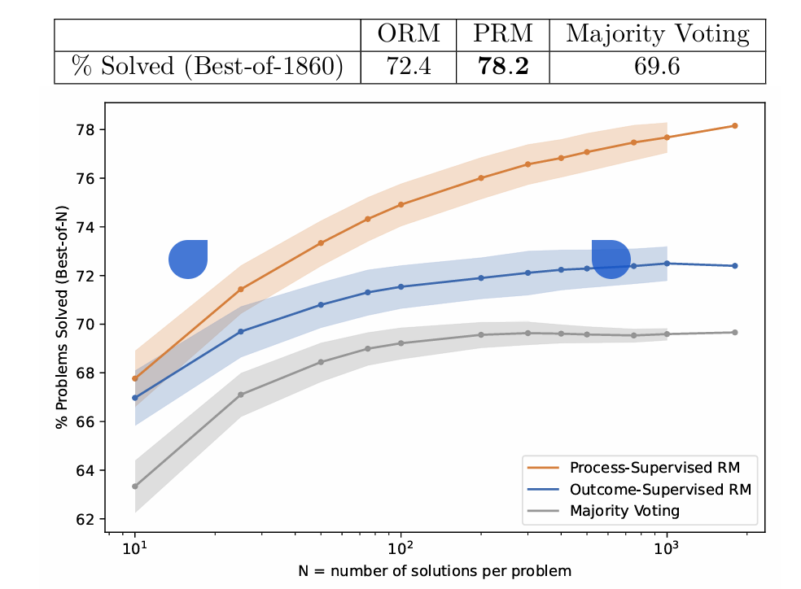
Comparison: CoT vs. PRM (Process Reasoning Models)
Hendrycks, C. Burns, S. Kadavath, A. Arora, S. Basart, E. Tang, D. Song, and J. Steinhardt. Measuring mathematical problem solving with the math dataset. arXiv preprint arXiv:2103.03874, 2021

Slide 32
Model Performance
LiveBench

Slide 33
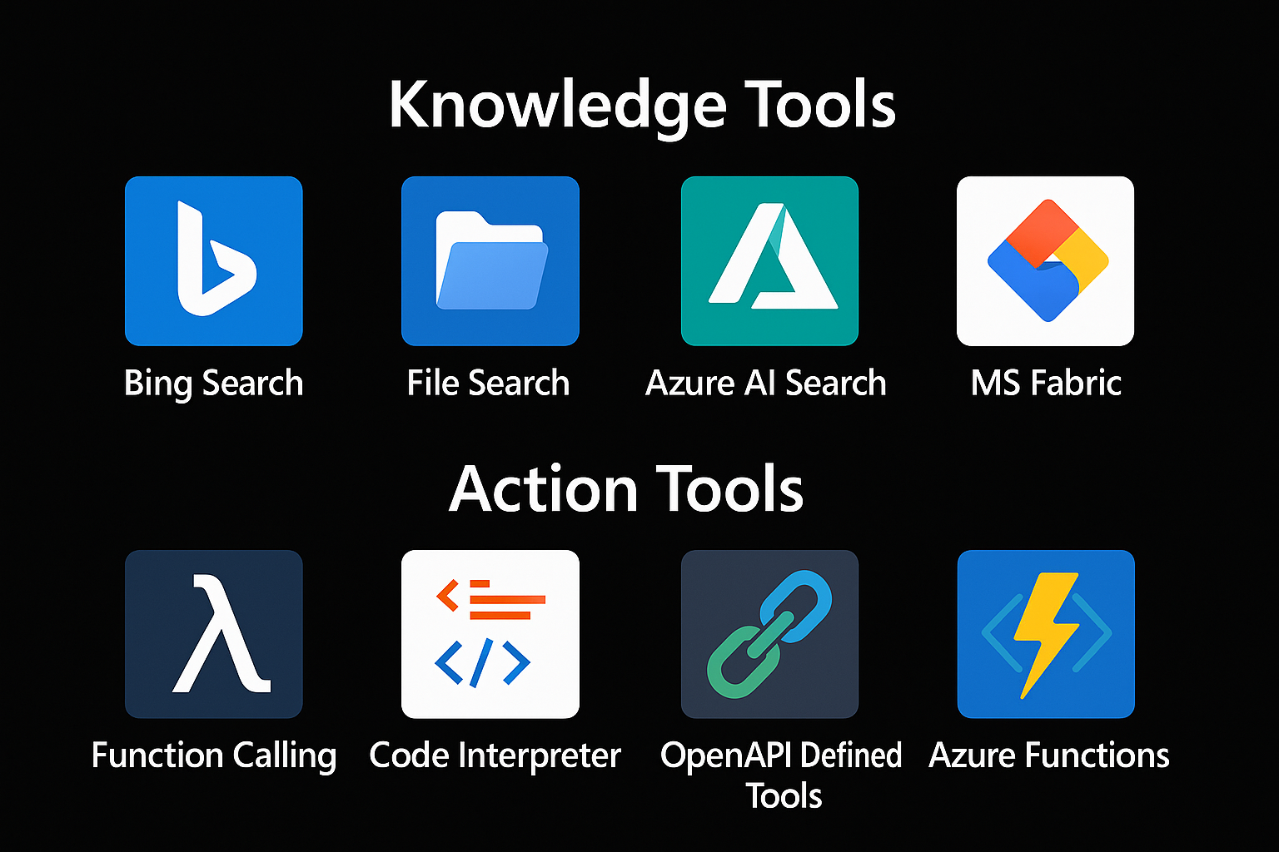

Extending Models
=> RAG
Tool 1
AGENT
=> Function Calling
Tool 2

Slide 34
RAG Retrieval Augmented Generation

Slide 35
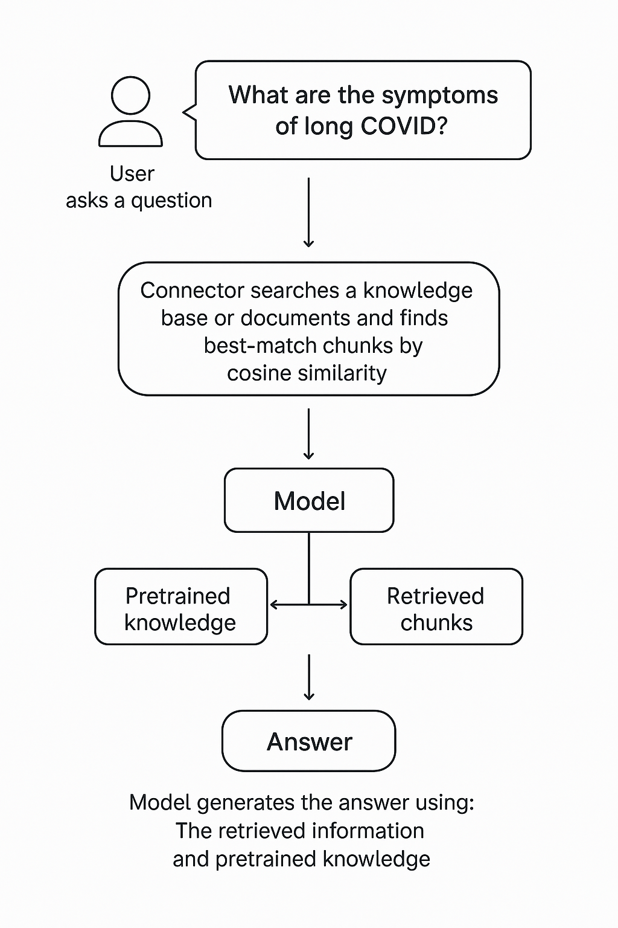
RAG Retrieval-Augmented Generation
Extending the model knowledge
Combines information retrieval with text generation
https://arxiv.org/abs/2005.11401

Slide 36
DEMO (c#)
Creating chunks
Creating embeddings
InMemory Vector DB
Calculating Similarity

Slide 37
Function Calling

Slide 38



Chat Model Interaction
User: How are you?
(1)
AI
Prompt
(2)
Assistent: I‘m fine, ho wcan I help you

Slide 39

Function Calling
User: Switch on the light to green.
LichtPlugin
SwitchLightOn(color)
SwitychLightOff
(1)
WeatherPlugin
ShowInfo(Location)
AI
Prompt
(2)
My Database
Tool: SwitchLightOn(green)
Schritt 2:
KI ermittelt aus dem Prompt die passende Funktion und Argumente. Bsp.:
SchallteLichAn(grün)
Plugin Library
Enthält die Beschreibungen von Funktionen.

Slide 40
Function Calling
{
"type": "function",
"function": {
"name": "get_weather",
"description": "Retrieves current weather for the given location.",
"strict": true,
"parameters": {
"type": "object",
"properties": {
"location": {
"type": "string",
"description": "City and country e.g. Bogotá, Colombia"
},
"units": {
"type": ["string", "null"],
"enum": ["celsius", "fahrenheit"],
"description": "Units the temperature will be returned in."
}
},
"required": ["location", "units"],
"additionalProperties": false
}
}
}

Slide 41
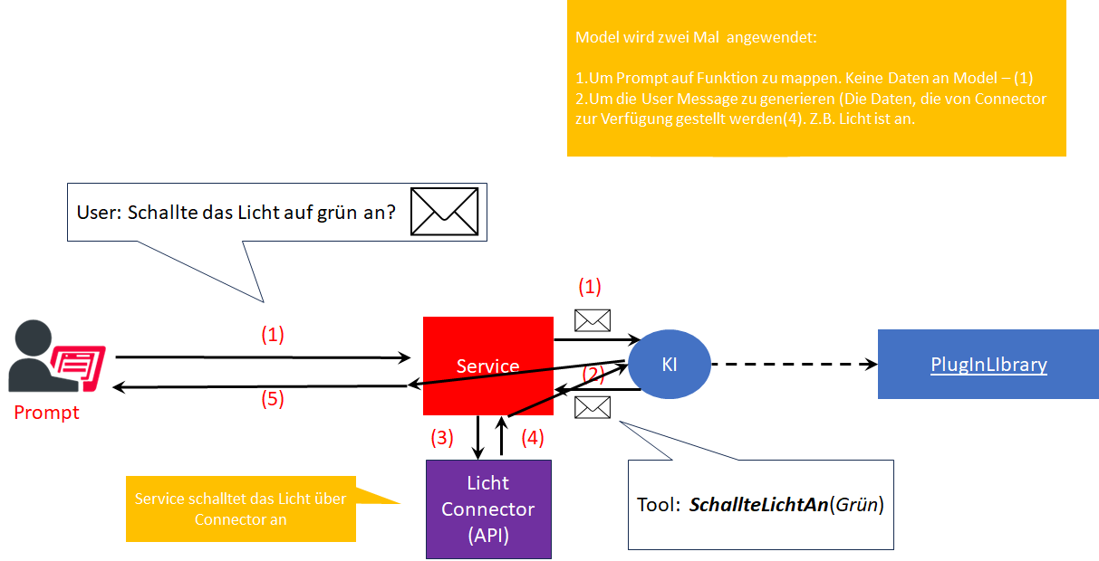
Function Calling
Schritt 2:
KI ermittelt aus dem Prompt die passende Funktion und Argumente. Bsp.:
SchallteLichAn(grün)
Plugin Library
Enthält die Beschreibungen von Funktionen.

Slide 42
Open AI Assistent vs. Azure Agent?
Both services enable you to build agents using the same API and SDKs.
Azure offers additional enterprise requirements as Azure AI Agent Service.
Flexible model selection Many Azure OpenAI models, or others such as Llama 3, Mistral and Cohere.
Extensive data integrations Grounding with secure enterprise knowledge from various data sources, such as Microsoft Bing, Azure AI Search, and other (your) APIs.
Enterprise grade security Ensure data privacy and compliance.

Slide 43
PROCESS FRAMEWORK
semantic-kernel/dotnet/samples/GettingStartedWithProcesses
Process Framework | Microsoft Learn

Slide 44
Process Framework
Tool 1
AGENT
Tool 2
Tool N

Slide 46
Microsoft confidential
Pause: 10.30-11.00
https://github.com/ddobric/semantic-kernel-training/

